Slide 1

Programación concurrente y distribuida
Leonardo Camargo Forero, M.Sc
Sesión CUDA

Slide 2
Contacto
Leonardo Camargo Forero, M.Sc
Asistente de Investigación - Computación Científica, Centro de Bioinformática y Biología Computacional. Ecoparque los Yarumos - Ed. BIOS
leonardo.camargo@ucaldas.edu.co

Slide 3
Agenda
General Purpose Computing on GPUs
Compute Unified Device Architecture
nVidia Corporation
CUDA definition
CUDA concepts
Important facts
Parallelization sheme MPI
Parallelization scheme CUDA
Kernels
C Programming
Compilation and Execution
Example: Matrix adding
Questions

Slide 4

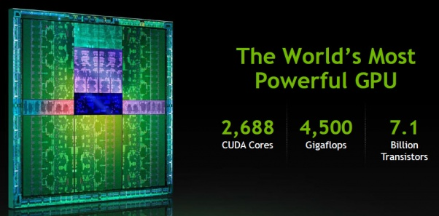
General purpose Computing
on GPUs

Slide 5
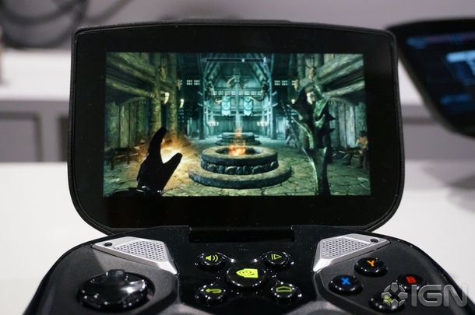


http://assets2.ignimgs.com/2013/06/13/dsc08004jpg-50eaf0_610w.jpg
http://blogs.nvidia.com/wp-content/uploads/2010/01/6a00d834515fca69e20120a7a8c7f7970b.jpg
http://www.fredberinger.com/images/onlive2.jpg

Slide 6

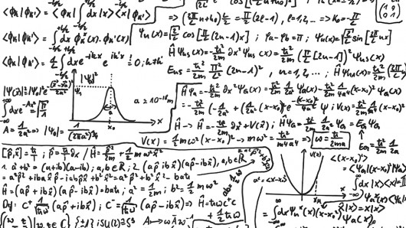
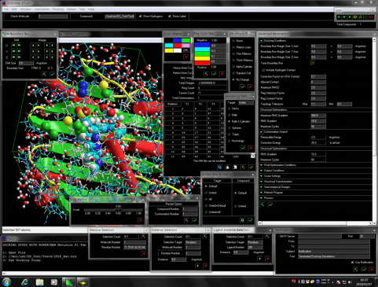
http://www.strangenotions.com/wp-content/uploads/Quantum.jpg
http://www.club-3d.com/tl_files/club3d/uploads/en/content/DirectX%2010.jpg
http://www.molfunction.com/images/RevF1-DS.gif

Slide 7
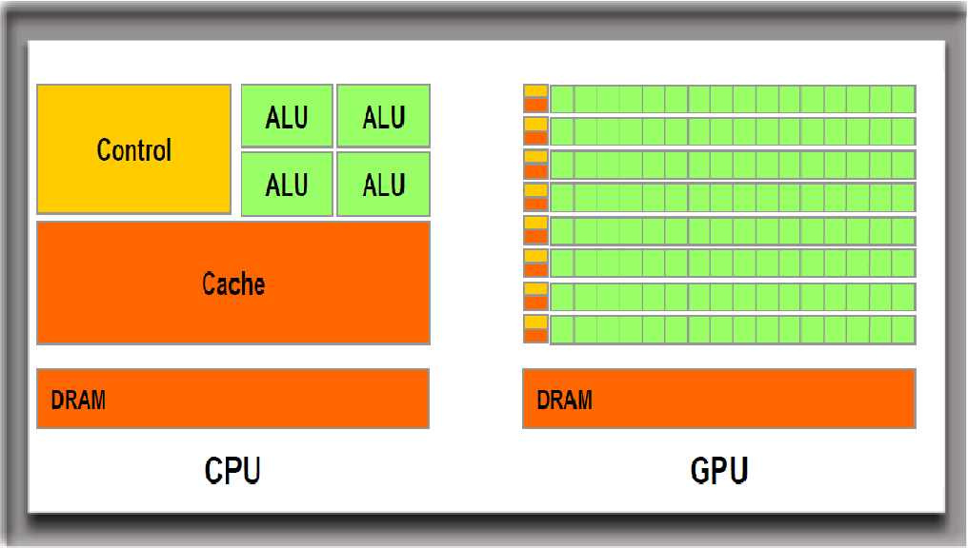
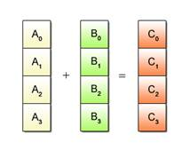
http://www.keremcaliskan.com/wp-content/uploads/2011/01/CPU-GPU-Structures1.png

Slide 8

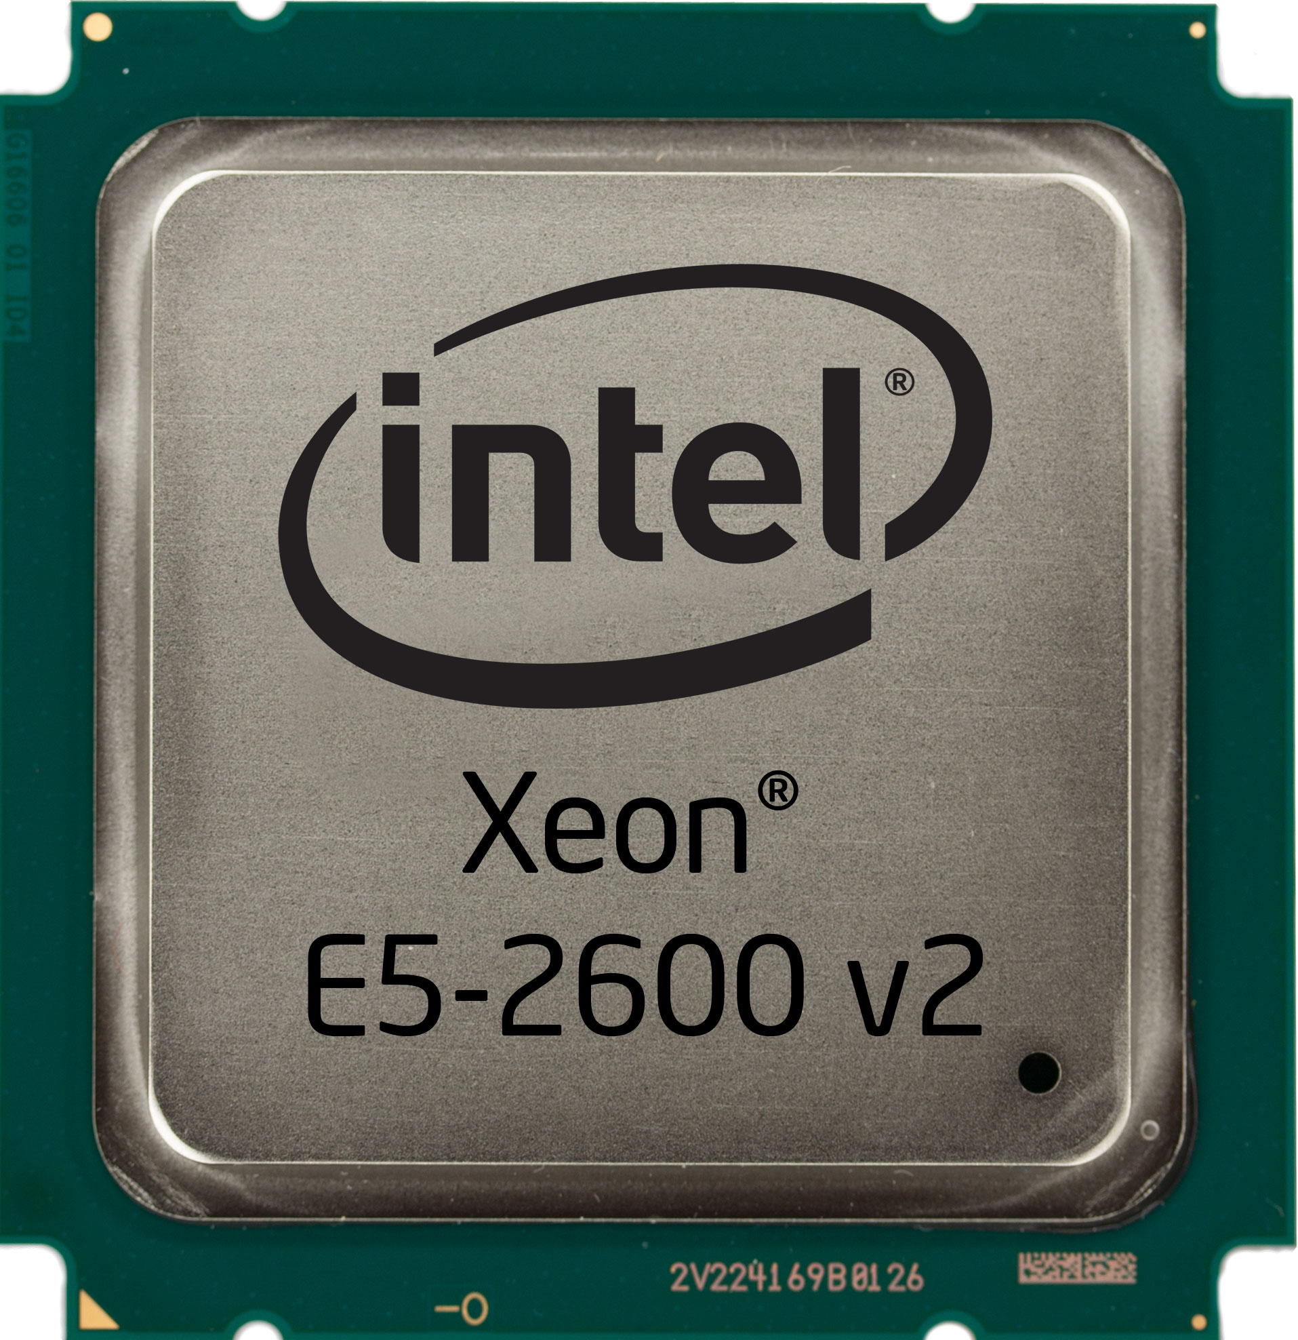
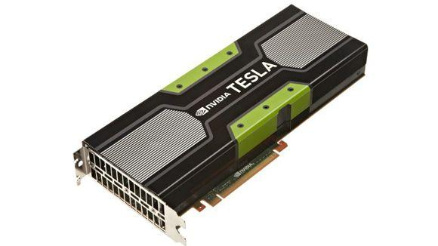
Multicore
Manycore

Slide 9

Hybrid Computing

Slide 10
Compute Unified Device Architecture
CUDA

Slide 11

nVidia Corporation
Born in 1993. Located at Santa Clara, California.
GPU manufacturer, SOCs manufacturer, Gaming industry, etc, etc.
Creator of CUDA in November 2006

Slide 12



CUDA
Computed Unified Device Architecture: General purpose parallel computing platform and programming model that leverages the parallel compute engine in NVIDIA GPUs to solve many complex computational problems in a more efficient way than on a CPU.
Taken from CUDA C Programming Guide, July 2013

Slide 13
CUDA Concepts
Host: CPU + RAM
Device: GPU + GPU RAM
Kernel: Subroutine to be executed on deviced
GPU Thread: Minimum execution unit (1D, 2D, 3D)
Block: Group of Threads (executed on independent SMs*) (1D, 2D, 3D)
Grid: Group of blocks (1D, 2D, 3D)
*SMs = Streaming Multiprocessors
CUDA MAIN IDEA: Use a thread per operation on different data

Slide 14
Important facts:
Each thread is assigned with an ID used for parallel Execution (threadIdx variable)
All threads of a block are expected to reside on the same processor core and must share the limited memory resources of that core
On current GPUs, a thread block may contain up to 1024 threads.
A kernel can be executed by multiple equally-shaped thread blocks, so that the total number of threads is equal to the number of threads per block times the number of blocks.
Blocks are organized into a one-dimensional, two-dimensional, or three-dimensional grid of thread blocks
The number of thread blocks in a grid is usually dictated by the size of the data being processed or the number of processors in the system, which it can greatly exceed.

Slide 15
Parallelization scheme MPI
Task
Node, Process, master thread, ID = 0
Main subtask
Main subtask
Subtask
Subtask
Distribución de datos
Subtask
Subtask
Subtask
Subtask
Subtask
Subtask
Nodes, Process, Slave Threads ID = {1,2,….n}
Subtasks quantity is application-dependent

Slide 16
Paralellization
Node, Process, master thread, ID = 0
Nodes, Processes, slave threads ID = {1,2,….n}
Main subtask
Subtask
Subtask
Subtask
Subtask
Data distribution
<Dara synchronization>
Node, Process, master thread. ID = 0
Subtask
Subtask
Subtask
Subtask
Main subtask
Nodes, Processes, slave threads ID = {1,2,….n}
Task

Slide 17
Parallelization scheme CUDA
Device Call
SIMD execution
threadID
threadID
threadID
threadID
Data block
Data block
Data block
Data block
KernelName <<< .. , … >>> (argList)
HOST
Output data

Slide 18
Kernels
C function executed N times in parallel by N different CUDA Threads
Declaration: __global__ (declaration specifier)
Execution syntax: kernelName <<< numBlocks, threadsPerBlock >>> (list_of_parameters)
Note: numBlocks = Grid size

Slide 19
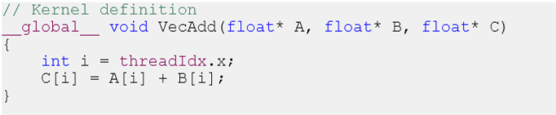
Kernel Example

Slide 20
C programming
General programing model
#include<cuda.h>
Kernel definition (__global__)
Host dynamic memory assignment
Device dynamic memory assignment
Host variable Initialization
Memory copy (Host to Device)
kernelName <<< numBlocks, threadsPerBlock >>> (list_of_parameters)
Memory copy (Device to Host)
…
….
….
….
NOTE: List of parameters should include output variables
Sequential execution
Parallel execution
Sequential execution
Sequential or parallel execution

Slide 21
Compilation and execution
nvcc code.c –o code (Compilation)
./code (Execution)
Installation requires nVidia GPU card Driver and CUDA Toolkit
Last CUDA version = 5.5

Slide 22
Example: Matrix adding
Description of the problem:
We have two big matrix and we want to calculate their sum in parallel. i.e A + B = C
General idea:
Launch one thread per resulting matrix element.

Slide 23
A
B
0,0 | 1,0 | 2,0 | 3,0 | 4,0 | 5,0 | 6,0 | 7,0
0,1 | 1,1 | 2,1 | 3,1 | 4,1 | 5,1 | 6,1 | 7,1
0,2 | 1,2 | 2,2 | 3,2 | 4,2 | 5,2 | 6,2 | 7,2
0,3 | 1,3 | 2,3 | 3,3 | 4,3 | 5,3 | 6,3 | 7,3
0,4 | 1,4 | 2,4 | 3,4 | 4,4 | 5,4 | 6,4 | 7,4
0,5 | 1,5 | 2,5 | 3,5 | 4,5 | 5,5 | 6,5 | 7,5
0,6 | 1,6 | 2,6 | 3,6 | 4,6 | 5,6 | 6,6 | 7,6
0,7 | 1,7 | 2,7 | 3,7 | 4,7 | 5,7 | 6,7 | 7,7
0,0 | 1,0 | 2,0 | 3,0 | 4,0 | 5,0 | 6,0 | 7,0
0,1 | 1,1 | 2,1 | 3,1 | 4,1 | 5,1 | 6,1 | 7,1
0,2 | 1,2 | 2,2 | 3,2 | 4,2 | 5,2 | 6,2 | 7,2
0,3 | 1,3 | 2,3 | 3,3 | 4,3 | 5,3 | 6,3 | 7,3
0,4 | 1,4 | 2,4 | 3,4 | 4,4 | 5,4 | 6,4 | 7,4
0,5 | 1,5 | 2,5 | 3,5 | 4,5 | 5,5 | 6,5 | 7,5
0,6 | 1,6 | 2,6 | 3,6 | 4,6 | 5,6 | 6,6 | 7,6
0,7 | 1,7 | 2,7 | 3,7 | 4,7 | 5,7 | 6,7 | 7,7
0,0 | 1,0 | 2,0 | 3,0 | 4,0 | 5,0 | 6,0 | 7,0
0,1 | 1,1 | 2,1 | 3,1 | 4,1 | 5,1 | 6,1 | 7,1
0,2 | 1,2 | 2,2 | 3,2 | 4,2 | 5,2 | 6,2 | 7,2
0,3 | 1,3 | 2,3 | 3,3 | 4,3 | 5,3 | 6,3 | 7,3
0,4 | 1,4 | 2,4 | 3,4 | 4,4 | 5,4 | 6,4 | 7,4
0,5 | 1,5 | 2,5 | 3,5 | 4,5 | 5,5 | 6,5 | 7,5
0,6 | 1,6 | 2,6 | 3,6 | 4,6 | 5,6 | 6,6 | 7,6
0,7 | 1,7 | 2,7 | 3,7 | 4,7 | 5,7 | 6,7 | 7,7
C
Sequential approach:
for(i=0;i<8;i++)
for(j=0;j<8;j++)
C[i][j]=A[i][j]+b[i][j]

Slide 24
Example: Matrix adding
C
0,0 | 1,0 | 2,0 | 3,0 | 4,0 | 5,0 | 6,0 | 7,0
0,1 | 1,1 | 2,1 | 3,1 | 4,1 | 5,1 | 6,1 | 7,1
0,2 | 1,2 | 2,2 | 3,2 | 4,2 | 5,2 | 6,2 | 7,2
0,3 | 1,3 | 2,3 | 3,3 | 4,3 | 5,3 | 6,3 | 7,3
0,4 | 1,4 | 2,4 | 3,4 | 4,4 | 5,4 | 6,4 | 7,4
0,5 | 1,5 | 2,5 | 3,5 | 4,5 | 5,5 | 6,5 | 7,5
0,6 | 1,6 | 2,6 | 3,6 | 4,6 | 5,6 | 6,6 | 7,6
0,7 | 1,7 | 2,7 | 3,7 | 4,7 | 5,7 | 6,7 | 7,7
Note the change in the position of the elements (i,j) in the matrix i.e. (5,4) -> (6,4)

Slide 25
Based-On-1-Block Solution
0,0 | 1,0 | 2,0 | 3,0 | 4,0 | 5,0 | 6,0 | 7,0
0,1 | 1,1 | 2,1 | 3,1 | 4,1 | 5,1 | 6,1 | 7,1
0,2 | 1,2 | 2,2 | 3,2 | 4,2 | 5,2 | 6,2 | 7,2
0,3 | 1,3 | 2,3 | 3,3 | 4,3 | 5,3 | 6,3 | 7,3
0,4 | 1,4 | 2,4 | 3,4 | 4,4 | 5,4 | 6,4 | 7,4
0,5 | 1,5 | 2,5 | 3,5 | 4,5 | 5,5 | 6,5 | 7,5
0,6 | 1,6 | 2,6 | 3,6 | 4,6 | 5,6 | 6,6 | 7,6
0,7 | 1,7 | 2,7 | 3,7 | 4,7 | 5,7 | 6,7 | 7,7
I = threadIdx.x
J = threadIdy.y
Some considerations:
All threads have access to the same memory space
Block may contain up to 1024 threads

Slide 26
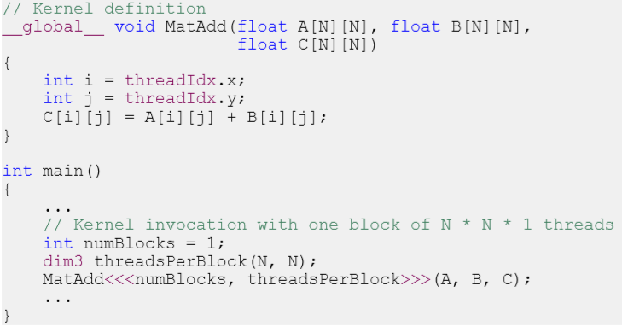
Based-On-1-Block Solution

Slide 27
Based-On-N-Block Solution (Equally-shaped blocks)
0,0 | 1,0 | 2,0 | 3,0 | 0,0 | 1,0 | 2,0 | 3,0
0,1 | 1,1 | 2,1 | 3,1 | 0,1 | 1,1 | 2,1 | 3,1
0,2 | 1,2 | 2,2 | 3,2 | 0,2 | 1,2 | 2,2 | 3,2
0,3 | 1,3 | 2,3 | 3,3 | 0,3 | 1,3 | 2,3 | 3,3
0,0 | 1,0 | 2,0 | 3,0 | 0,0 | 1,0 | 2,0 | 3,0
0,1 | 1,1 | 2,1 | 3,1 | 0,1 | 1,1 | 2,1 | 3,1
0,2 | 1,2 | 2,2 | 3,2 | 0,2 | 1,2 | 2,2 | 3,2
0,3 | 1,3 | 2,3 | 3,3 | 0,3 | 1,3 | 2,3 | 3,3
0,0
1,0
0,1
1,1
I = threadIdx.x + blockIdx.x*blockDim.x
J = threadIdy.y + blockIdx.y*blockDim.y
Some considerations:
Threads only have access to their block memory space
Block may contain up to 1024 threads

Slide 28
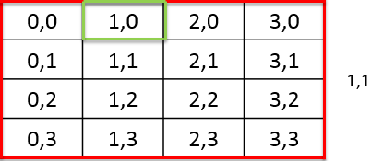
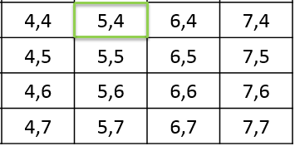
Grid Representation
Matrix
blockIdx.x = 4
blockIdx.y = 4
I = threadIdx.x + blockIdx.x*blockDim.x = 1 +1*4 = 5
J = threadIdy.y + blockIdx.y*blockDim.y = 0 +1*4 = 4
Just as each thread has an identifier (threadIdx) so each block has one (blockIdx)

Slide 29
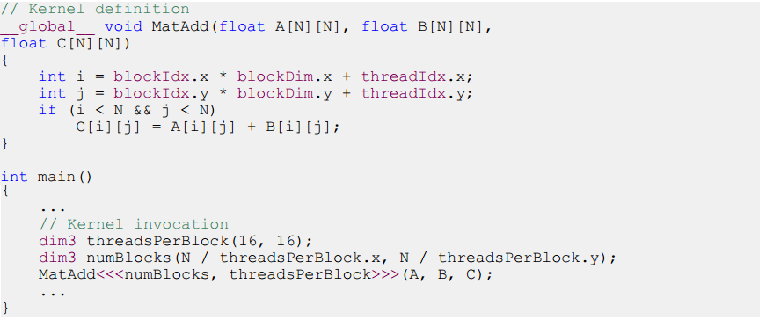
Based-On-N-Block Solution

Slide 30


